Slide 1
The Impacts of Modern Empire and the Languages of the American South
Seth (Dani) Katenkamp
Committee: Claire Bowern, Jason Shaw, Alejandra Dubcovsky, and Jack Martin
(07 May 2025)

Slide 2
Roadmap
1. Main questions
2. Sources of data
1. Introduction (main questions)
Contact in industrialized empires, variable outcomes
2. Sources of Data
Prepping corpora
Choctaw
3. Methodology for empirical work
Variables
Interpretation
4. Population models
5. The plan
3. Methodology for empirical work
4. Population models

Slide 3
1. The high-level questions
2. Sources of data
3. Methodology for empirical work
4. Population models

Slide 4
Language contact
When different languages come into contact, a variety of language change phenomena occur:
Borrowing, neologization, morphosyntactic restructuring, language shift, creolization
Does a unique contact scenario → unique language change?
Specifically: What types of change do we expect in a contact ecology characterized by the dynamics of modern colonialism?

Slide 5
Dynamics of modern colonialism
Global empire → attempts at genocide and erasure
Capitalism → conflicting ideologies of trade/value (Galloway, 2009)
Industrialization → devaluing of traditional lifeways, disrupting restorative practices re ecosystem
Replacing previous methods of sustenance with collaborative mass production
New trades, fields of expertise
Urbanization → displacement from traditional environment, mixing of communities (Oakland, Los Angeles, Oklahoma City, etc.)
Mass media → increased/ubiquitous exposure to dominant language
Initially paired with a lack of access to that communication infrastructure for their own language

Slide 6
Expectations/Intuitions
General inundation, combined with socioeconomic incentives lead to greater proficiency in colonial L2, and more code switching
More borrowing
Resort to hypernyms to fill gaps created by the loss of infrequent lexical items
General language shift
Altered set of appropriate domains for language use
Non-native spatial domains: corporate environments, industrial workplaces, urban areas, locations of forced migration, etc.
Cessation of traditional lifeways, especially ceremonies and material culture

Slide 7
Complicating those expectations
Counter-examples:
Shift to polysynthesis in Bardi in the 20th century (Bowern, 2012)
Borrowing prevented by language-mixing taboos (Epps, 2009)
Specific attitudinal factors prevent the expected change!
Localized effects:
Color with particular referents
Borrowing prohibited in particular social domains, e.g. ceremony
Prevents attrition or replacement of native vocabulary in that part of the lexicon
Less frequent use of borrowings in social elites (Katenkamp, 2025)
Revitalization/reclamation/resistance movements
Young people’s varieties, mixed languages, creoles complicate narratives of attrition
So contact-based change
Isn’t always either attrition or shift (better characterized as a variety of changes)
What happens is often determined partly by societal attitudes

Slide 8
The big questions
How do speakers of Indigenous languages change their behavior in response to modern (industrial and imperial) history?
What sorts of domain specificity (speaker subgroup, speech domain, region of the lexicon, etc.) do we see in these changes?
How do these changes relate to individual sociopolitical events and community values, e.g. when do speakers assimilate versus dissimilate?
Notes:
“How does the cultural practice of speaking Choctaw (or the other languages in the
study) change in response to its sociopolitical environment?”

Slide 9
Narrowing the focus
The contexts and trends relevant to those questions are too varied and complicated to explore at a global scale
cf. Bromham et al.’s (2022) study of likelihood of endangerment as a singular variable
So we look at a few languages in the American South
Extremes of colonialism:
Very old European-Native American contact
Shatter Zone period (1540-1715) involved extensive migration, coalescence of disparate groups, and population decline
Small pluralistic confederacies victims of American expansion and Removal to Oklahoma
Indigenous groups here have similar social architecture and experiences of European contact, but there still exists cultural and historical variation between them.

Slide 10
Specific opportunities for observation
Muskogean languages
Earliest material is from the 18th century
1740 for Mvskoke/Creek
1775 for Choctaw
Significant corpora from the 19th and early 20th centuries
Modern documentation to compare to

Slide 11
1. The high-level questions
2. Sources of data
3. Methodology for empirical work
4. Population models

Slide 12
What exists?
Lots of scattered written material, typically produced by Native people for Native people, from about 1740-1910
Written material from later in the 20th century via language documentation (e.g. Haas, 1944, 1945)
Some recordings from the 21st century (also language documentation)
Mainly Choctaw, Creek, Koasati
3/4 branches of the family
On the order of a few 100k words / each language
(Ask me in the Q&A about specific materials/languages)

Slide 13
Basic (maximal) pipeline for prepping corpora
Complete translations
(Find repositories, digitize)
Write to consistent JSON format
Partition, transcribe
Parse/gloss
Fill in missing metadata
(where things vary)

Slide 14
Choctaw
Going to focus on Choctaw material (specifically 19th century), because that material is fully processed
Basic facts about the Historical Choctaw Corpus:
630k words
Several hundred speakers
Demographic variation: age, social class, race, gender

Slide 15
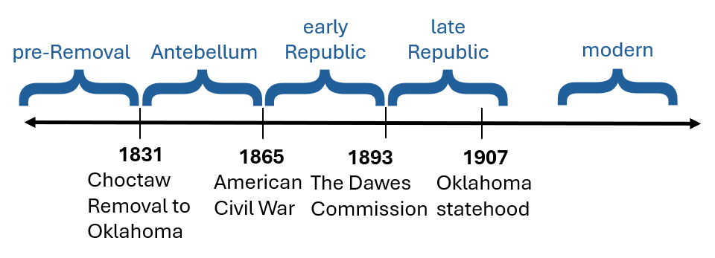
Sub-corpora
Time periods chosen based on important socio-political events
The middle three intervals are similar in length (34, 28, 24 years)
Other subdivisions that might be significant?
Genre (alt. macro-genre, which is more coarse-grained)
Speaker class
Medium (transcribed speech versus written composition)
Notes:
Explain how each event connects to a relevant source of language change

Slide 16
Genres for Choctaw
Historical Choctaw Corpus
(Miscellaneous) Evangelical Legal Personal
Narrative
Federal
Admin
Letter
Editorial

Slide 17
Unevenly attested (number of utterances)
 | evangelical | legal | personal | total
pre-Removal | 1664 | 724 | 000 | 2388
Antebellum | 3284 | 51 | 1753 | 5088
early Republic | 43 | 14085 | 106 | 14234
late Republic | 000 | 10122 | 214 | 10336
total | 4991 | 24982 | 2073 | 32046

Slide 18
1. The high-level questions
2. Sources of data
3. Methodology for empirical work
4. Population models

Slide 19
Variables
Meakins et al. (2019)
“language features” for which there are variant expressions
Variants may originate in one language or another, or be innovative
Lexical and morphosyntactic variables
“The 120 language features were chosen because they vary rather than for their specific patterns of change (such as simplification) in order not to bias the analysis.”
Useful methodology because
We identify maximally local changes
Not as vulnerable to empirical gaps (cf. alternative methodologies for finding out if the total lexicon has shrunk)

Slide 20
Different types of variables
Lexical vs. morphosyntactic
Borrowings: ‘donkey’ issoba in haksobish falaaya
‘like a deer, with long ears’
mul
Hypernymy: ‘wine’ oka homi
‘bitter water, liquor’
panki okchi
‘wine, grape juice’

Slide 21
Different types of variables (cont.)
Options for constructions: where one lives
(a) (place) aayahanta (b) (place) aayokchanya
aa- atta -hVn aa- okchaya -n
loc- be.at -rep loc- live -dur
‘be there (continually)’ ‘living there, being alive there’
General use of complex morphology: How consistently are coordinate clauses marked with switch reference?

Slide 22
Axes of variation
Meakins et al. (2019) look at variants in a mixed language which can be tagged for two different properties:
(a) Gurindji, Kriol, or innovative origin
(b) simple or complex
This allows the trends in the usage of variants for each variable to be identified as indicating shift along the axes of
(a) preference for forms from one of the source languages
(b) preference for simplicity
Two possible axes for the Muskogean data: hypernymization and Anglicization

Slide 23
Hypernymization
“Simplicity” as a concept is ethically and formally fraught
Absolute complexity: “the number of elements…the amount of information needed to describe them,” e.g. conjugation classes, number of contrasts, etc. (Nichols, 2009:111)
An example from Meakins et al. (2019:294): “borrowing prepositions over case morphology”
Hypernymy eschews metrics of complexity in the language system for more descriptive properties
Are there fewer lexical items in use in the language?
Intuitive transmission advantage to a smaller lexicon- but that doesn’t automatically mean that’s what happens

Slide 24
Anglicization
Obviously full borrowings from English, but also semantic borrowings (Brown, 1999), e.g. correr for ‘run for office’ in Brazilian Portuguese
Changes in the number of contrasts
Increase to match English: color terms
Decrease to match English: sibling terms, pluractional marking in verbs

Slide 25
Interpreting distribution
Thinking about individual texts
So we don’t over-represent large texts
So we can think about the distribution of behavior across individuals in the population
Two types of changes that can happen to the distribution of a given variable:
Change in average use of a variant (across the population)
Change in how widely distributed the individual behaviors are (stdev)
Working out the social dynamics that produce the two types of change using a population model

Slide 26
1. The high-level questions
2. Sources of data
3. Methodology for empirical work
4. Population models

Slide 27
Modeling goals:
Identifying specific parameters that generate the two types of change
A mixture of bias (for or against a variant), strength of conformity to different parts of the population, etc.
By working out the parameters that generate a particular trajectory, we establish quantitatively the strength of the bias (and possibly the types of bias) active for that variable
Comparing to a null model, where the distribution is the result of non-selective drift
Establishes a likelihood of social selection

Slide 28
Overall structure of the model (for one variable)
Population of constant size
Individuals have a single value representing how frequently they use the target variant of the variable
Randomly assigned based on a truncated Gaussian distribution ([0:1]) centered on the mean of variant use across the population
So no separate phases of innovation and then spread
Discrete timesteps: what happens?
Individuals are randomly paired together to ‘interact’ until all individuals have interacted at least once
Interaction changes the frequency of both individuals (see next slide)
After all interactions take place, the mean across the population is updated
Then some of the population is replaced (a “mortality rate” parameter)

Slide 29
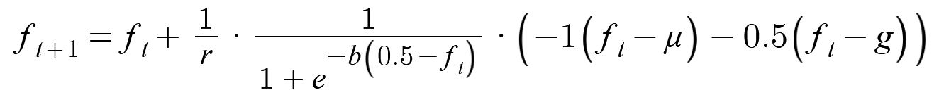
‘Interaction’ between individuals
f = speaker’s frequency of use (0 < f < 1)
r = speaker’s resistance to change
b = population general bias towards the variant
μ = mean frequency of use across population (0 < μ < 1)
g = interlocutor frequency of use (0 < g < 1)
t = timestep
amount that the frequency will change
current frequency
resistance
bias towards variant
(sigmoidal)
contextual pull, a function of the speaker’s distance from the general mean and their interlocutor’s use

Slide 30
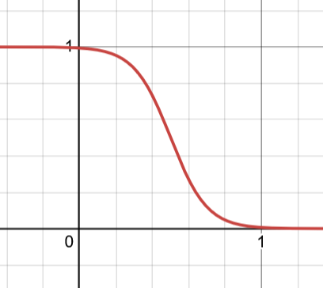
Some assumptions
Speakers have some awareness of the general trend in their population, beyond the scope of their current interaction
Unlike models like Kirby (1998)
Speakers in the real world encounter their language ambiently
Bias calculated via sigmoid function: the closer speakers are to whichever pole they’re biased towards (0 or 1), the weaker the effect

Slide 31
Some assumptions to change in future versions of the model
Currently the resistance to change is the same for all speakers
No social subclasses
Segregation
Behavioral differences (e.g. propensity towards borrowing, Katenkamp, 2025)
No selection for replacement based on age
(these are all parameters which should be added)

Slide 32
Interpreting results
Changes in mean = changes in the population’s use of variant
The b (bias) necessary to generate the shape of the curve (the change in m) show the degree to which the change in frequency could be the result of drift
Greater bias, less likely to be drift
Distribution of the population: wide or narrow
Width in a given timestep isn’t necessarily insightful
But change in width represents homogenization/heterogenization of the population’s behavior (suggesting social salience)
Changes in the model parameters mid-simulation in order to capture changes in trajectory

Slide 33
Comparing results for different significant variables
Different variables will behave differently- which ones behave similarly? (same changes at the same times)
Do mid-simulation changes correlate between variables? Do they correlate with moments of dramatic sociopolitical change?
This is both a question for the empirical work and the modeling
Translating to the ‘properties’ of variables, e.g. hypernymization

Slide 34
5. The plan
“Work I will do”

Slide 35
What work needs to be done?
Correlation between variables/historical events
Writing code
Gathering data
Configuring corpora
Modeling
WRITING

Slide 36
Schedule and chapter outline
Summer 2025:
write Python scripts to efficiently gather distributional data
prep Mvskoke Creek material
Formatting Koasati texts from Kimball (2010)
Fall 2025 and Spring 2026:
keep working Mvskoke material
start gathering data that can be identified automatically
manually tagging corpora for the variables that cannot be automated
writing background (Chapters 3 and 4, draft of Chapter 1)
Summer 2026:
continue gathering data
finish historical profile/chapters
Fall 2026 and Spring 2027:
(finish gathering data if necessary)
modeling
data analysis, writing Chapters 5-8
writing the historical relation chapters (Chapters 10, 11)
Chapter 1- Introduction
Chapter 2- History of contact and sociopolitical change in the Southeast
Chapter 3- Background [theoretical lit review]
Chapter 4- Measuring granular change [build on the prospectus]
Chapter 5- Trends in clausal morphology
Chapter 6- Trends in the range of syntactic structures
Chapter 7- Trends pertaining to hypernymy
Chapter 8- Trends in borrowing [build on QP2]
Chapter 9- More general conclusions from
Chapter 10- Summary of genre and social class localization
Chapter 11- Summary of localization within the lexicon
Chapter 12- Conclusion

Slide 37
References
Bowern, Claire. (2012). A Grammar of Bardi. De Gruyter Mouton.
Bromham, Lindell, Russell Dinnage, Hedvig Skirgard, Andrew Ritchie, Marcel Cardillo, Felicity Meakins, Simon Greenhill, Xia Hua. (2022). “Global predictors of language endangerment and the future of linguistic diversity.” Nature Ecology and Evolution. Vol. 6. Pp. 163-173
Brown, Cecil. (1999). Lexical Acculturation in Native American Languages. Oxford University Press.
Epps, Patience. (2009). “Loanwords in Hup, a Nadahup language of Amazonia.” in The loanword typology project and the world loanword database. Eds. Martin Haspelmath and Uri Tadmor. De Gruyter Mouton. Pp. 992-1014.
Galloway, Patricia. (2009). “Choctaws at the Border of the Shatter Zone: Spheres of Exchange and Spheres of Social Value.” In Mapping the Mississippian Shatter Zone: The Colonial Indian Slave Trade and Regional Instability in the American South. Eds. Robbie Ethridge and Sheri M. Shuck-Hall. University of Nebraska. Pp. 333-364.
Haas, Mary. (1944). “Men’s and Women’s Speech in Koasati.” Language. Vol. 20:3. Pp. 142-149.
Haas, Mary. (1945). “Dialects of the Muskogee Language.” International Journal of American Linguistics. Vol. 11:2. Pp. 69-74.
Katenkamp, Seth. (2025). “Lack of prestige in use of English borrowings in nineteenth century Choctaw society.” Qualifying paper. Yale University.
Kirby, Simon. (1998). “Language evolution without natural selection: From vocabulary to syntax in a population of learners.” Edinburgh Occasional Papers in Linguistics.
Krifka, Manfred. (2021). “Layers of assertive clauses: Propositions, judgements, commitments, acts.” In Propositionale Argumente im Sprachvergleich: Theorie und Empirie./Propositional Arguments in Cross-Linguistic Research: Theoretical and Empirical Issues. Eds. J. M. Hartmann and A. Wöllstein. Gunter Narr. Pp. 1-41.
Meakins, Felicity, Xia Hua, Cassandra Algy, Lindell Bromham. (2019). “Birth of a contact language did not favor simplification.” Language. Vol. 95:2. Pp. 294-332.
Nichols, Johanna. (2009). “Linguistic complexity: a comprehensive definition and survey.” Language Complexity as an Evolving Variable. Eds. Geoffrey Sampson, David Gil, Peter Trudgill. Oxford University Press. Pp. 110-126
Thank you to Claire, to the folks who have agreed to be on my committee (Jason, Alejandra, and Jack), to Aaron and Jonah for building the Historical Choctaw Corpus with me, and to Finn and Mike for teaching me a lot about math in the past few weeks!

